Slide 1
FE EXAM PREPARATION
CE 4200 Professional Engineering Practice Issues
SPRING 2022 Semester
William D. Lawson, P.E., Ph.D.

Slide 2
Three Assumptions to this Lecture
You have taken the Mock FE Exam
You have your MFE Score Report
You create a Tailored FE Preparation Plan (Bonus HW3)

Slide 3
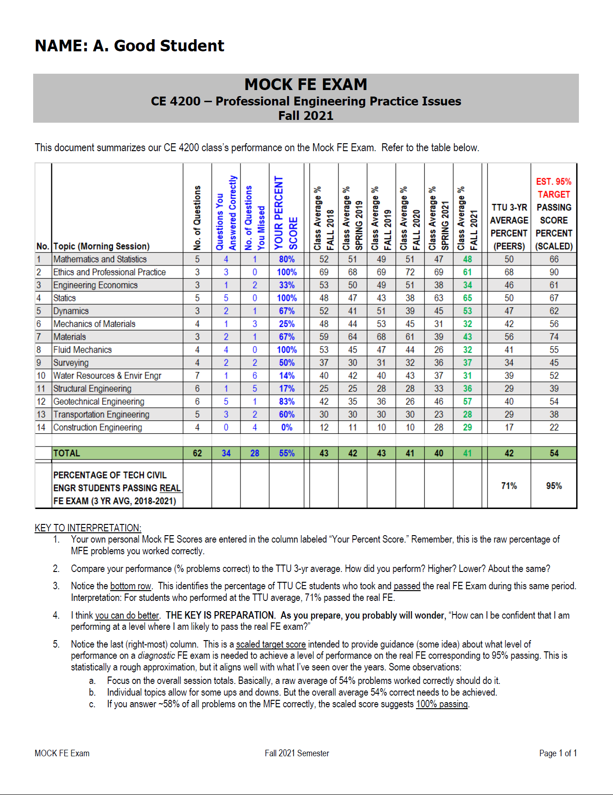

Slide 4
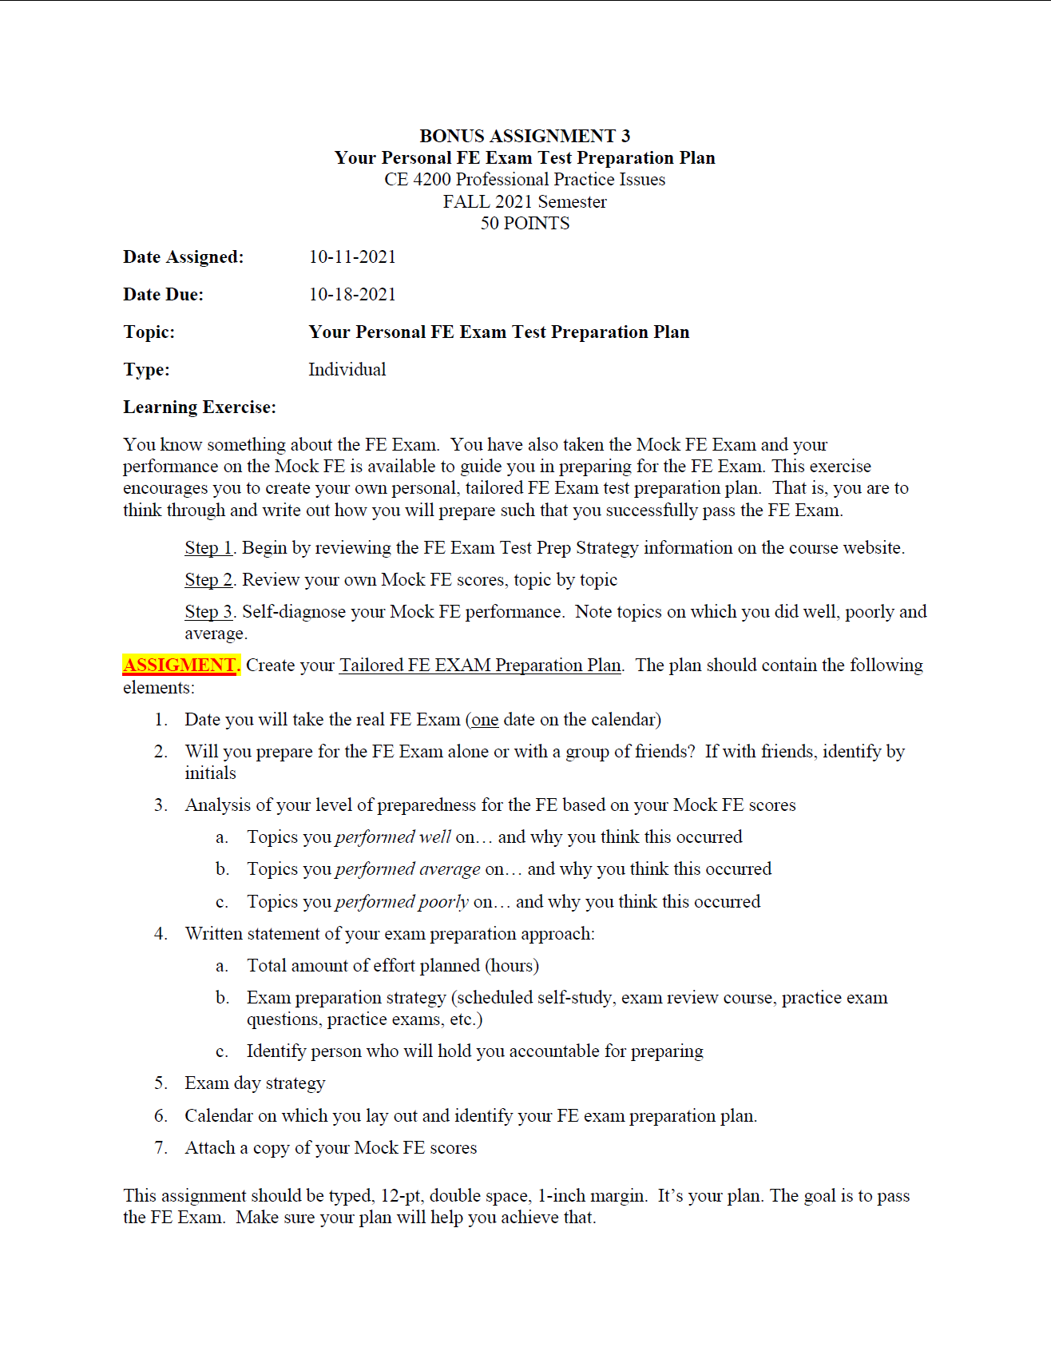

Slide 5
CE 4200 Professional Engineering Practice Issues
HOW TO PREPARE

Slide 7


Slide 8
CE 4200 Professional Engineering Practice Issues
MOCK FE AS A BASELINE

Slide 10
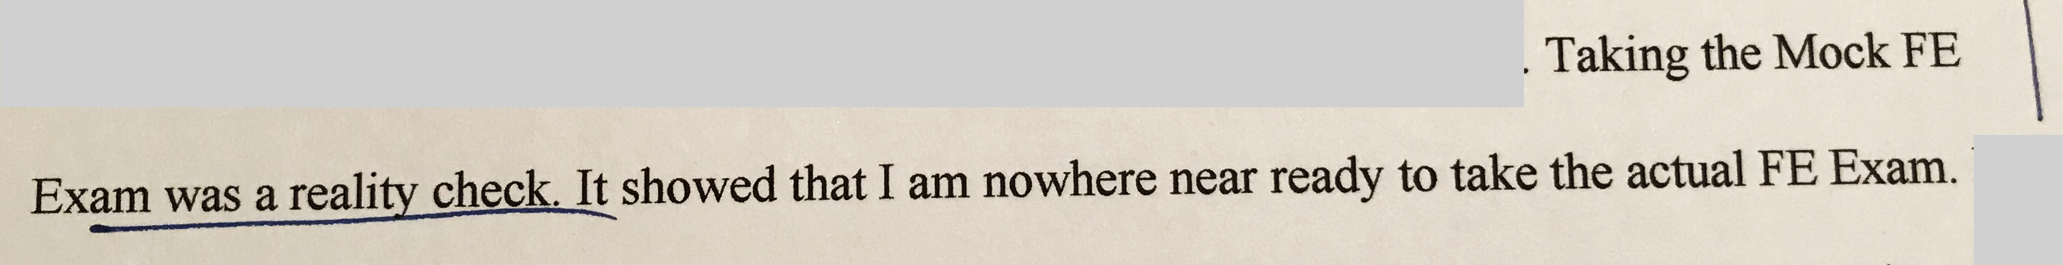

Slide 11
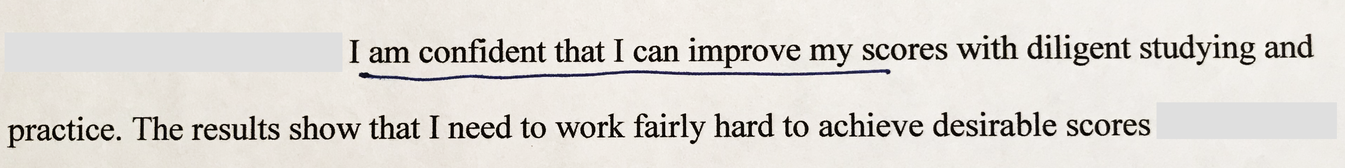

Slide 12
CE 4200 Professional Engineering Practice Issues
ASSESSMENT OF PERFORMANCE

Slide 13
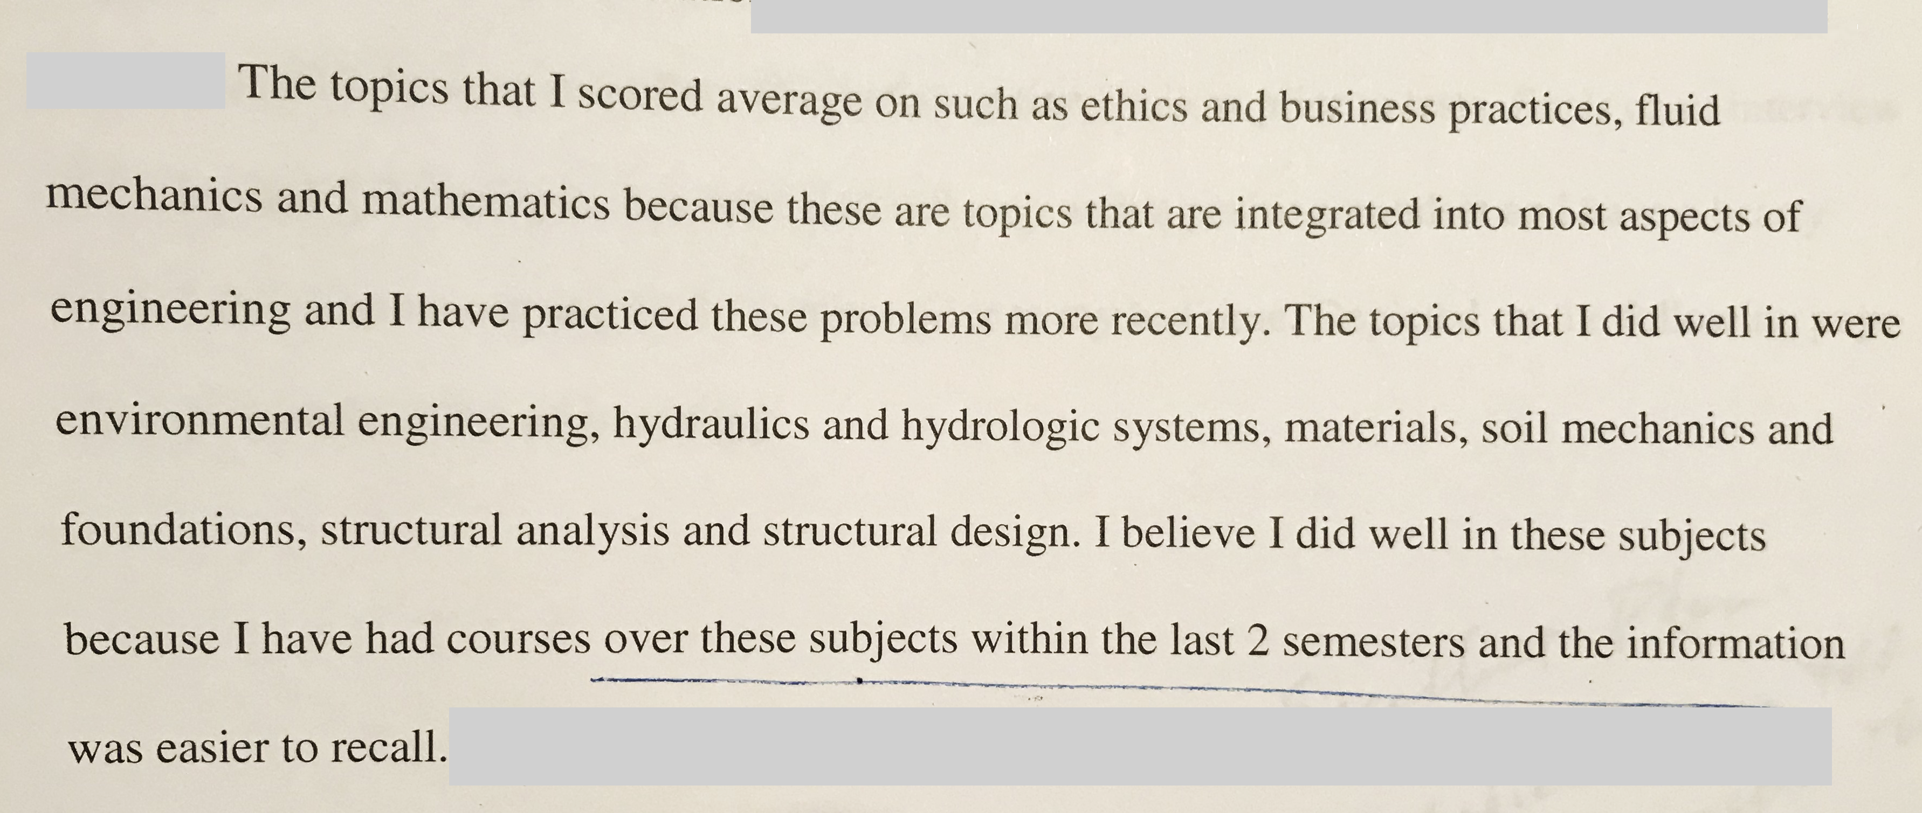

Slide 14
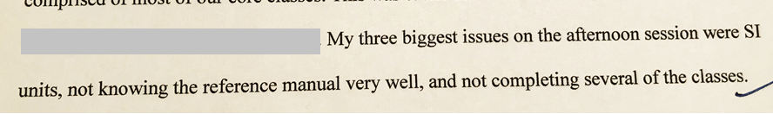

Slide 15
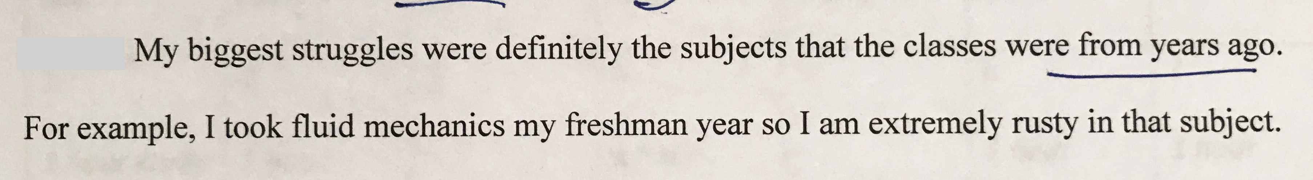

Slide 16
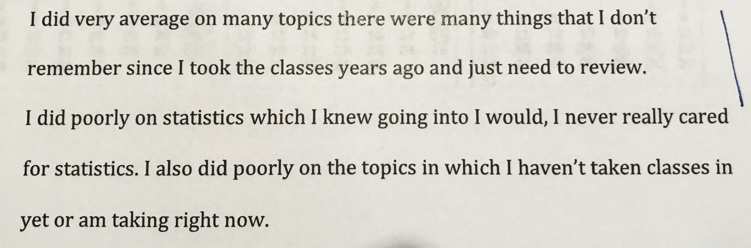

Slide 17
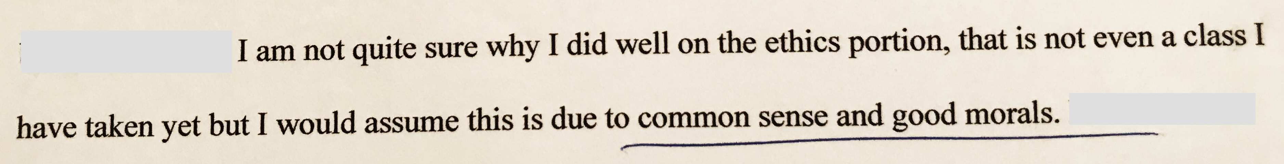

Slide 19
CE 4200 Professional Engineering Practice Issues
FAMILIARITY WITH NCEES REFERENCE HANDBOOK

Slide 20
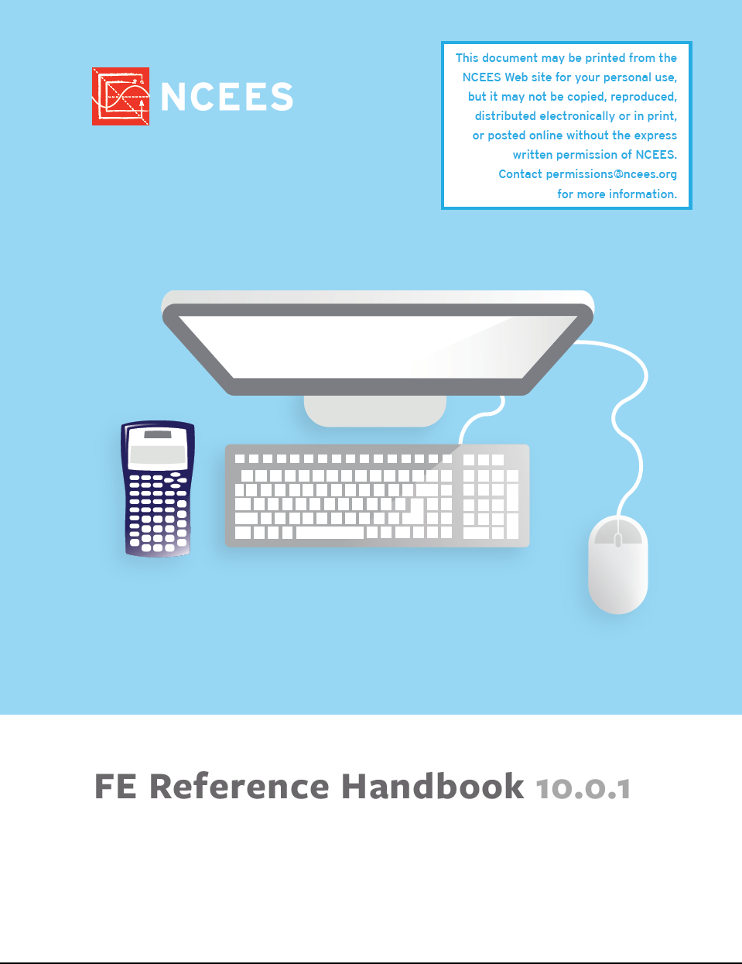

Slide 21
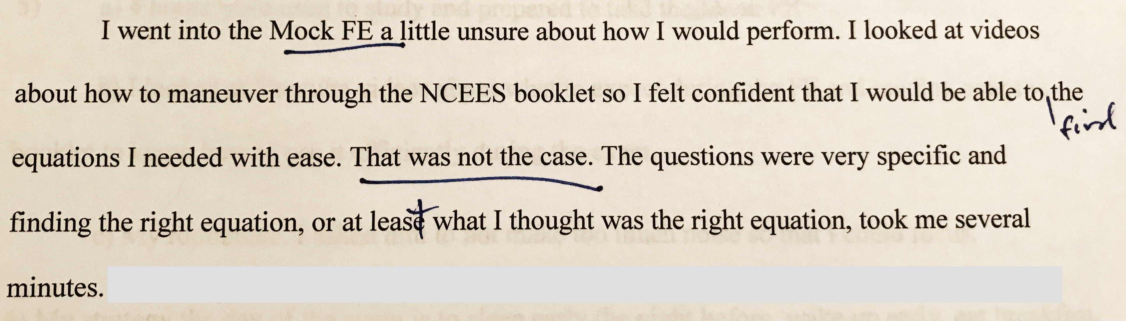

Slide 22
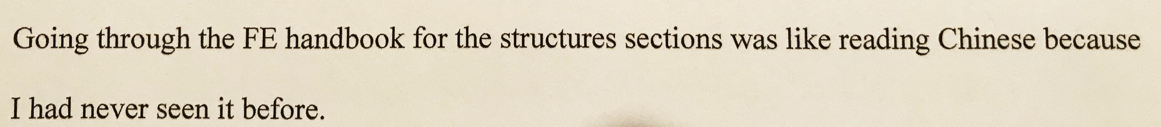

Slide 23
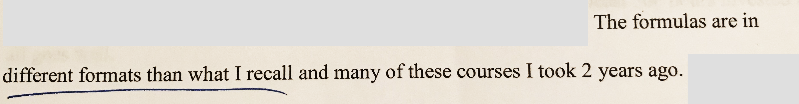

Slide 24
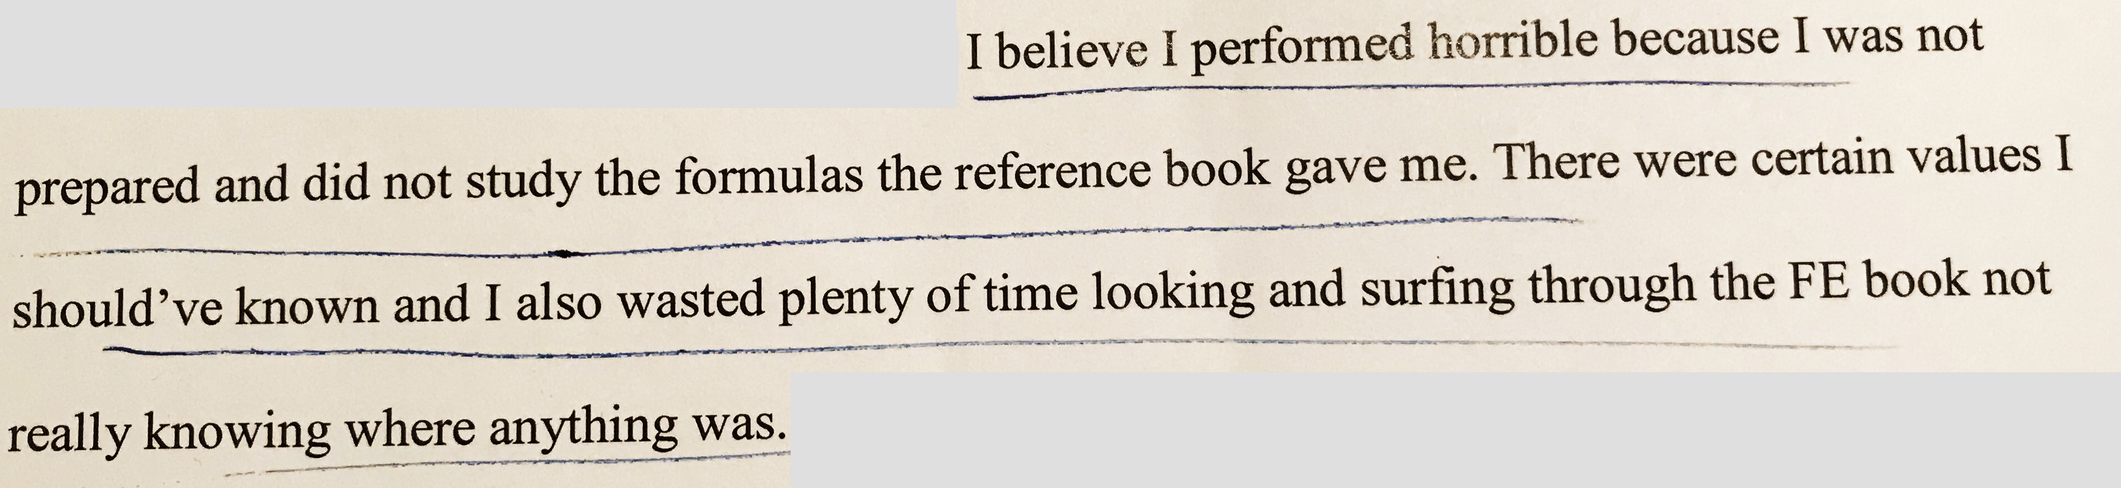

Slide 25
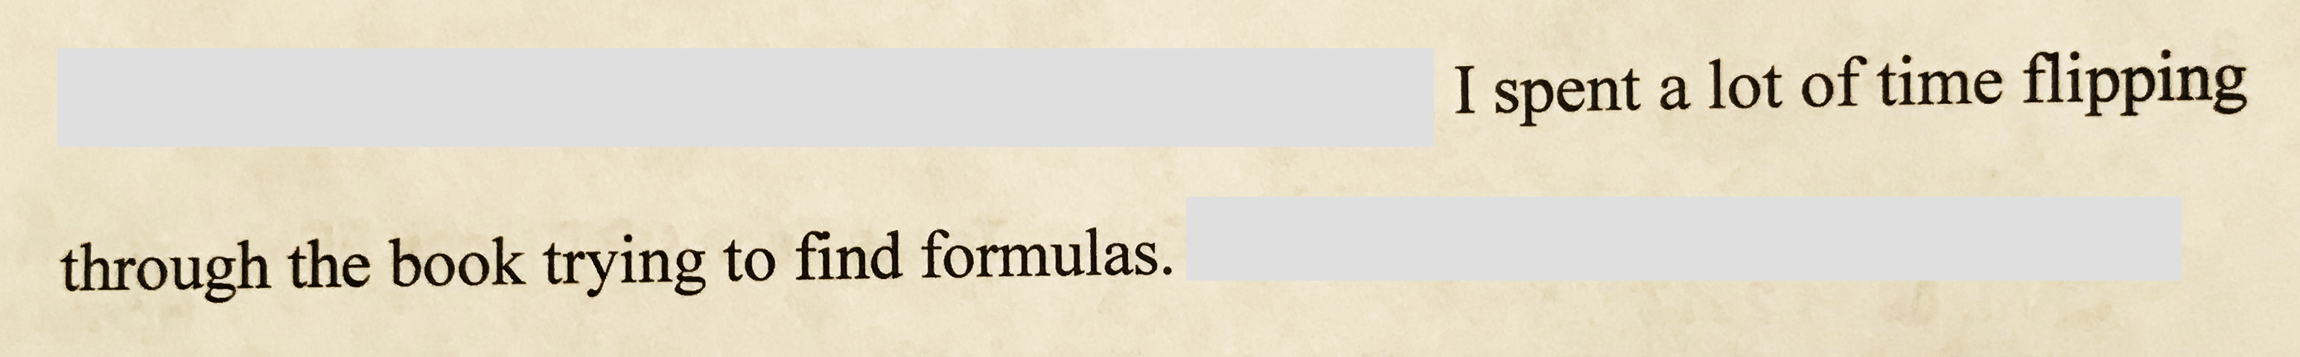

Slide 26
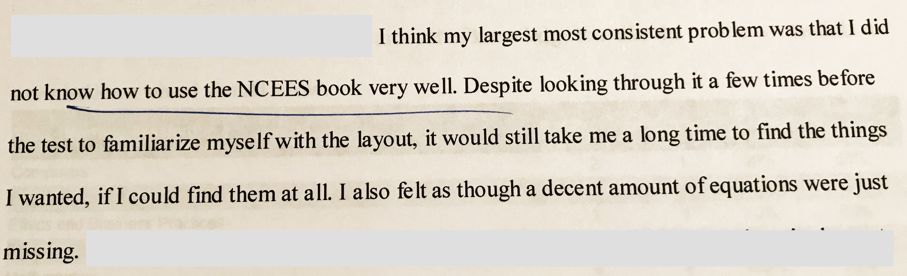

Slide 27
CE 4200 Professional Engineering Practice Issues
PRACTICE EXAMS

Slide 28
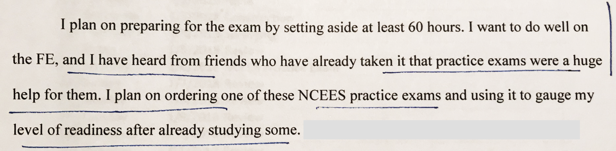

Slide 31
CE 4200 Professional Engineering Practice Issues
EXAM PREP SCHEDULE

Slide 34
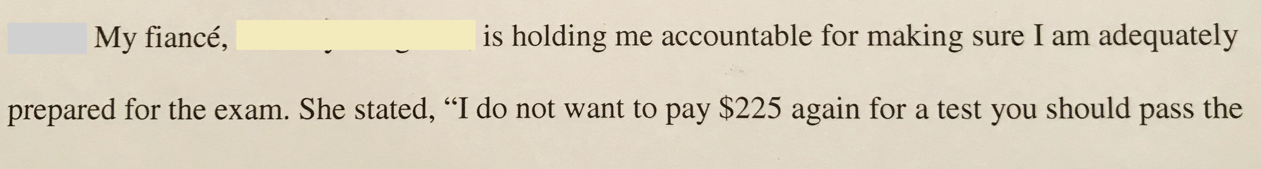

Slide 35
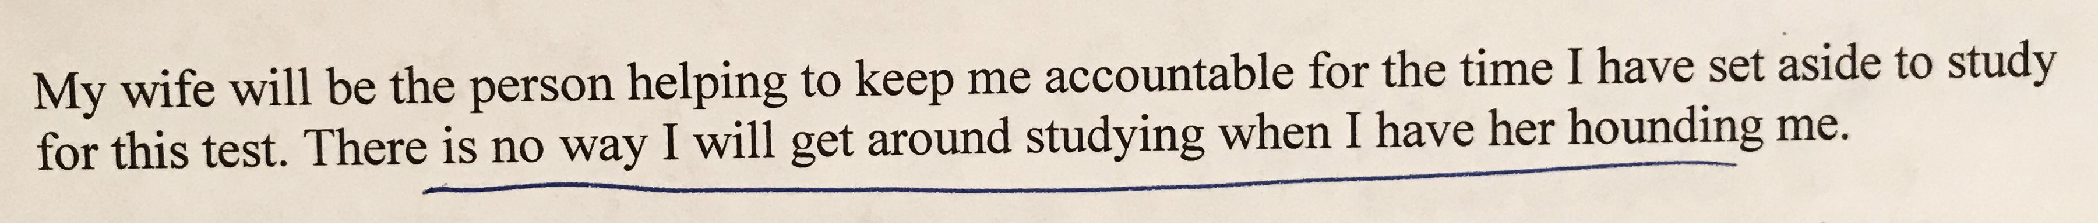

Slide 36
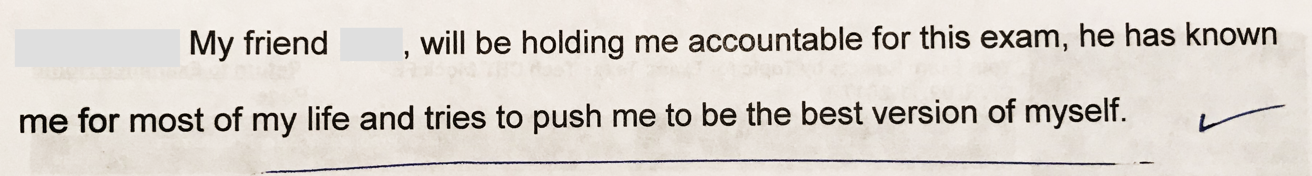

Slide 37
CE 4200 Professional Engineering Practice Issues
EXAM DAY RITUALS…

Slide 38
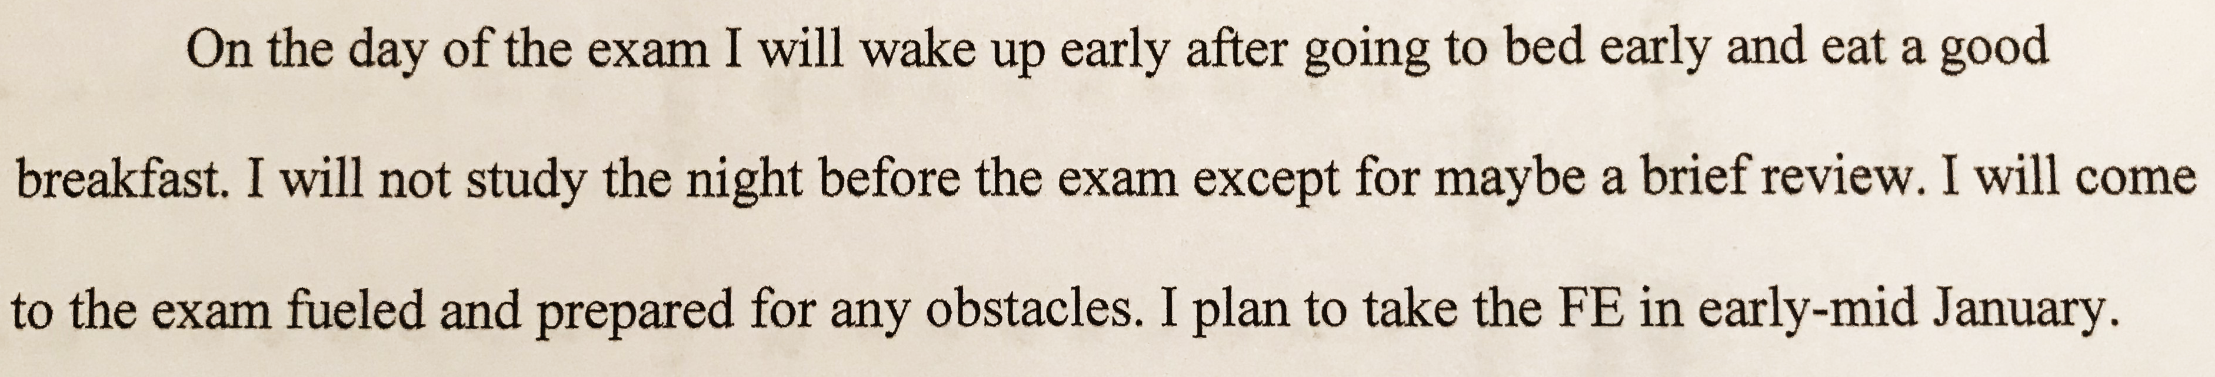

Slide 39
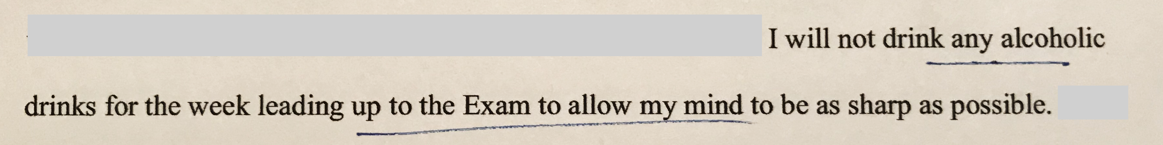

Slide 40
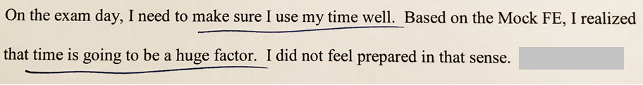

Slide 42
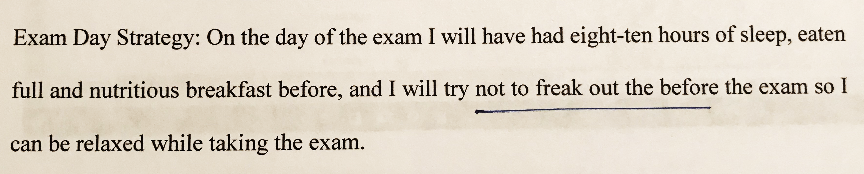

Slide 43
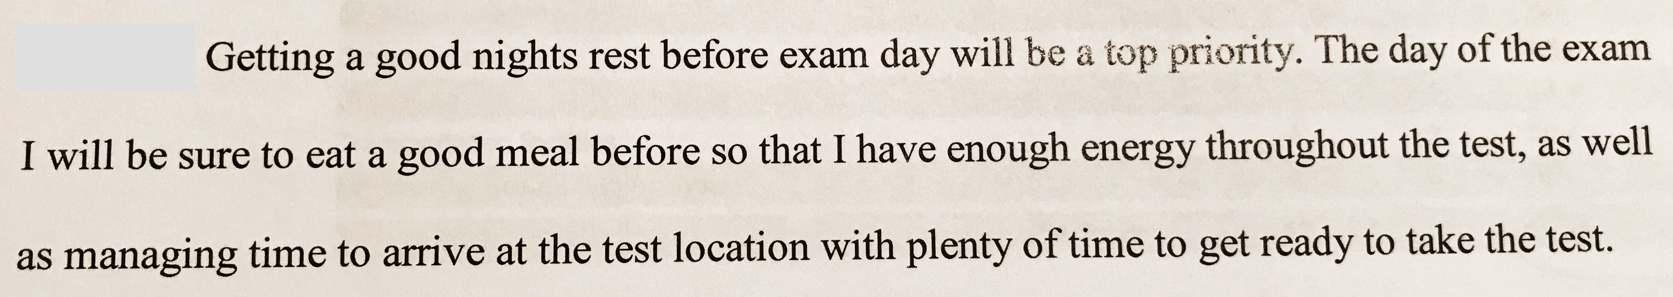

Slide 44
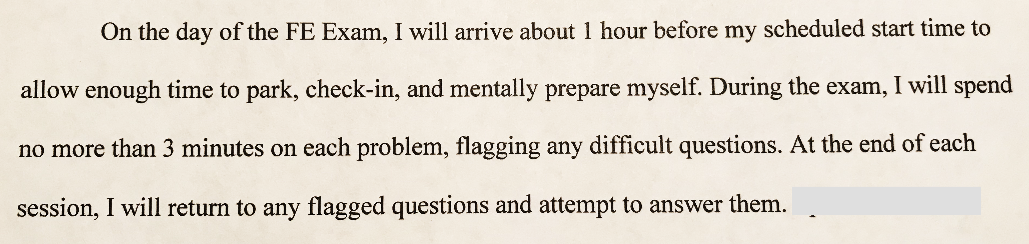

Slide 47
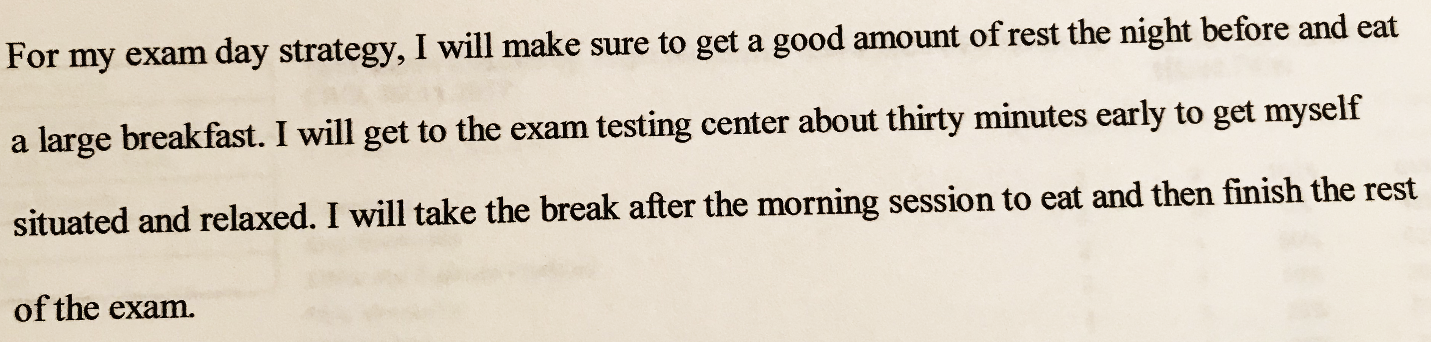

Slide 48


